Slide 1

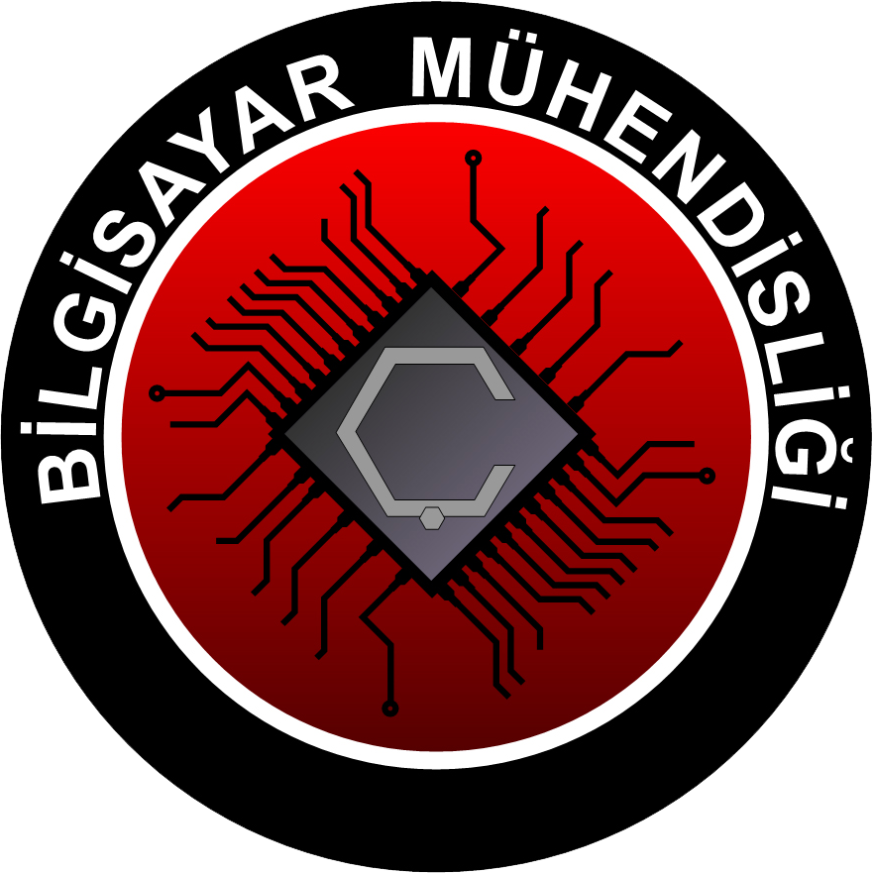
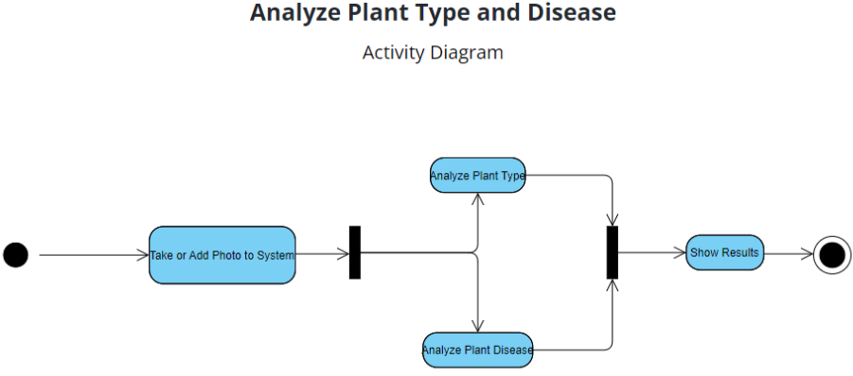
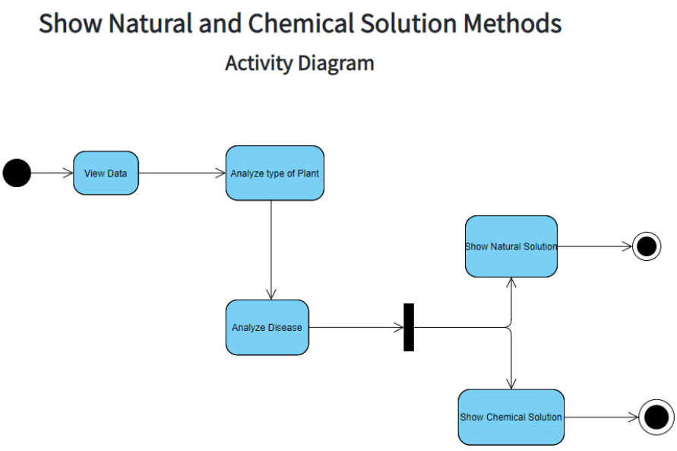
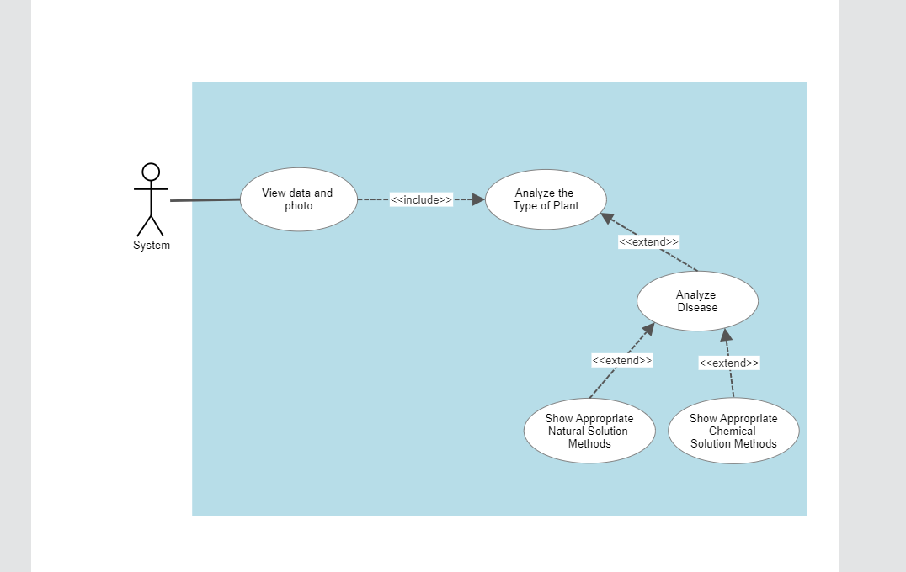
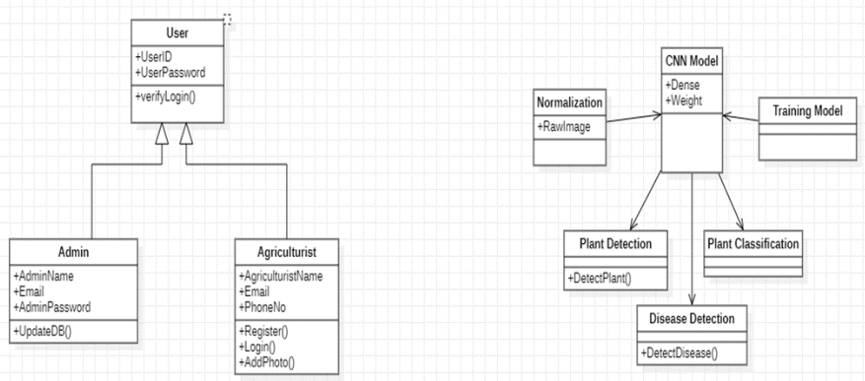
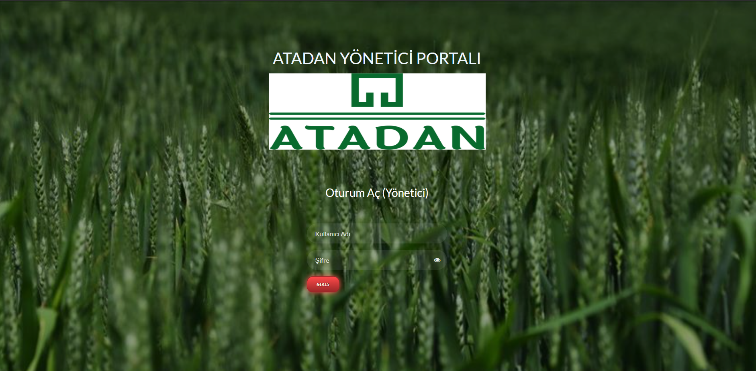
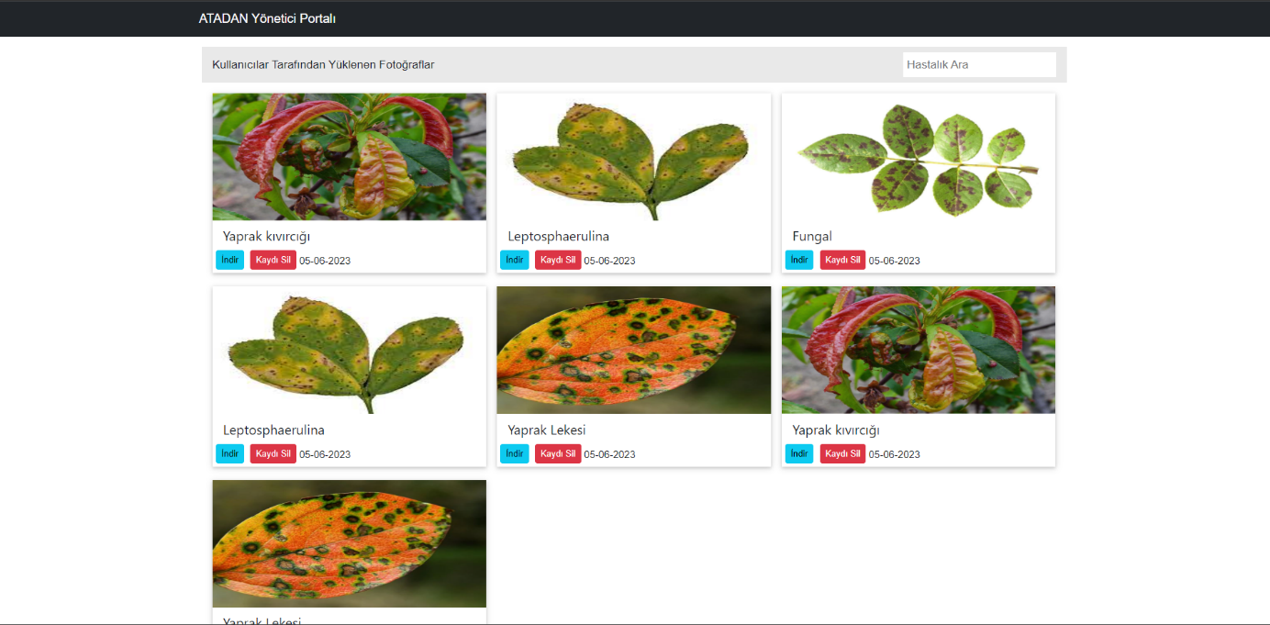
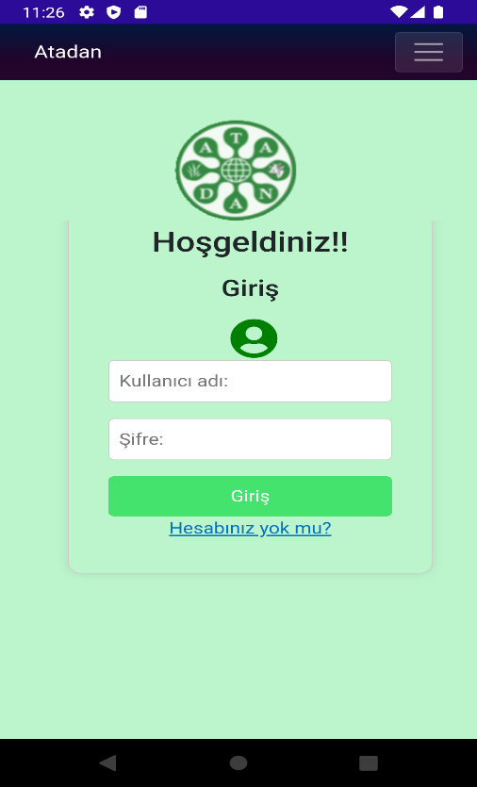
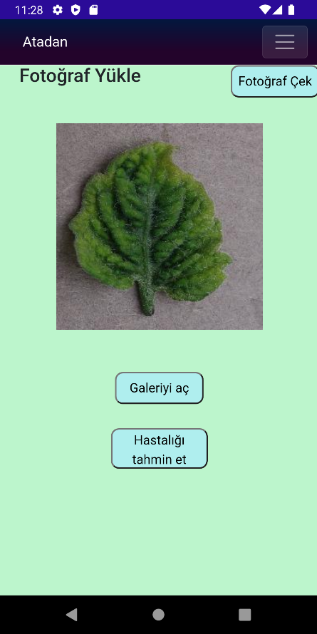
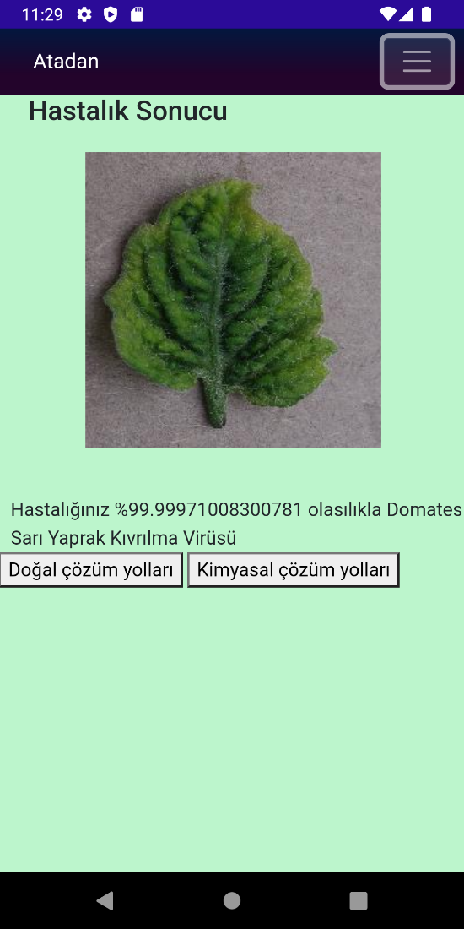
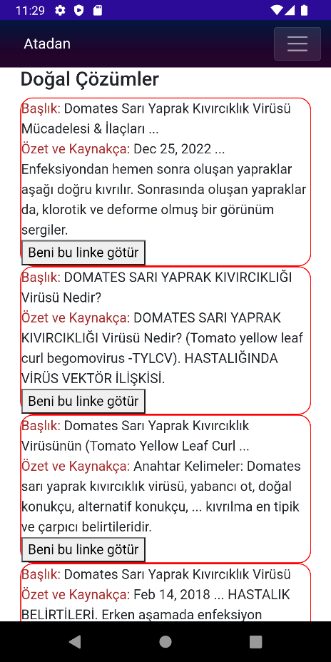
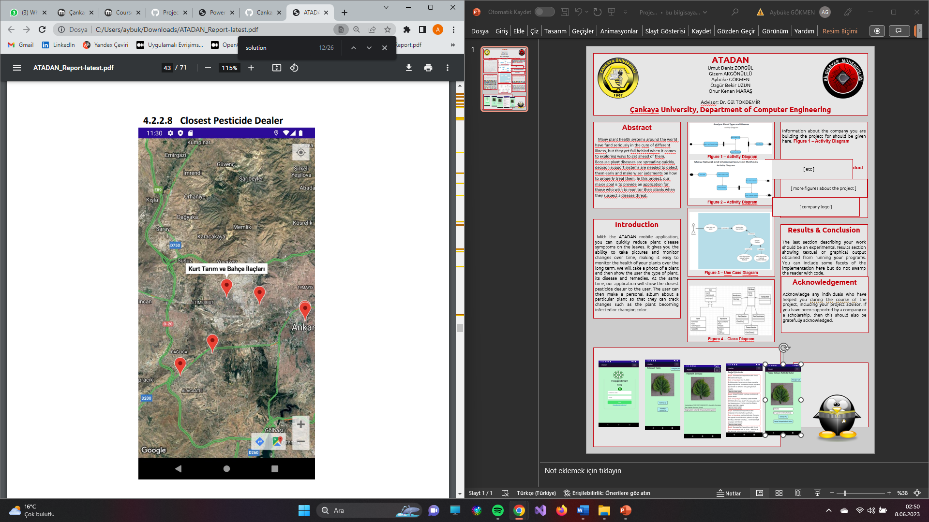
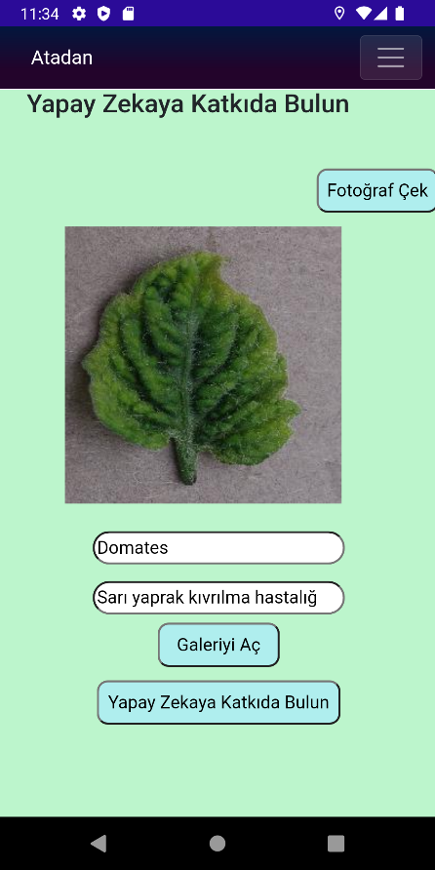
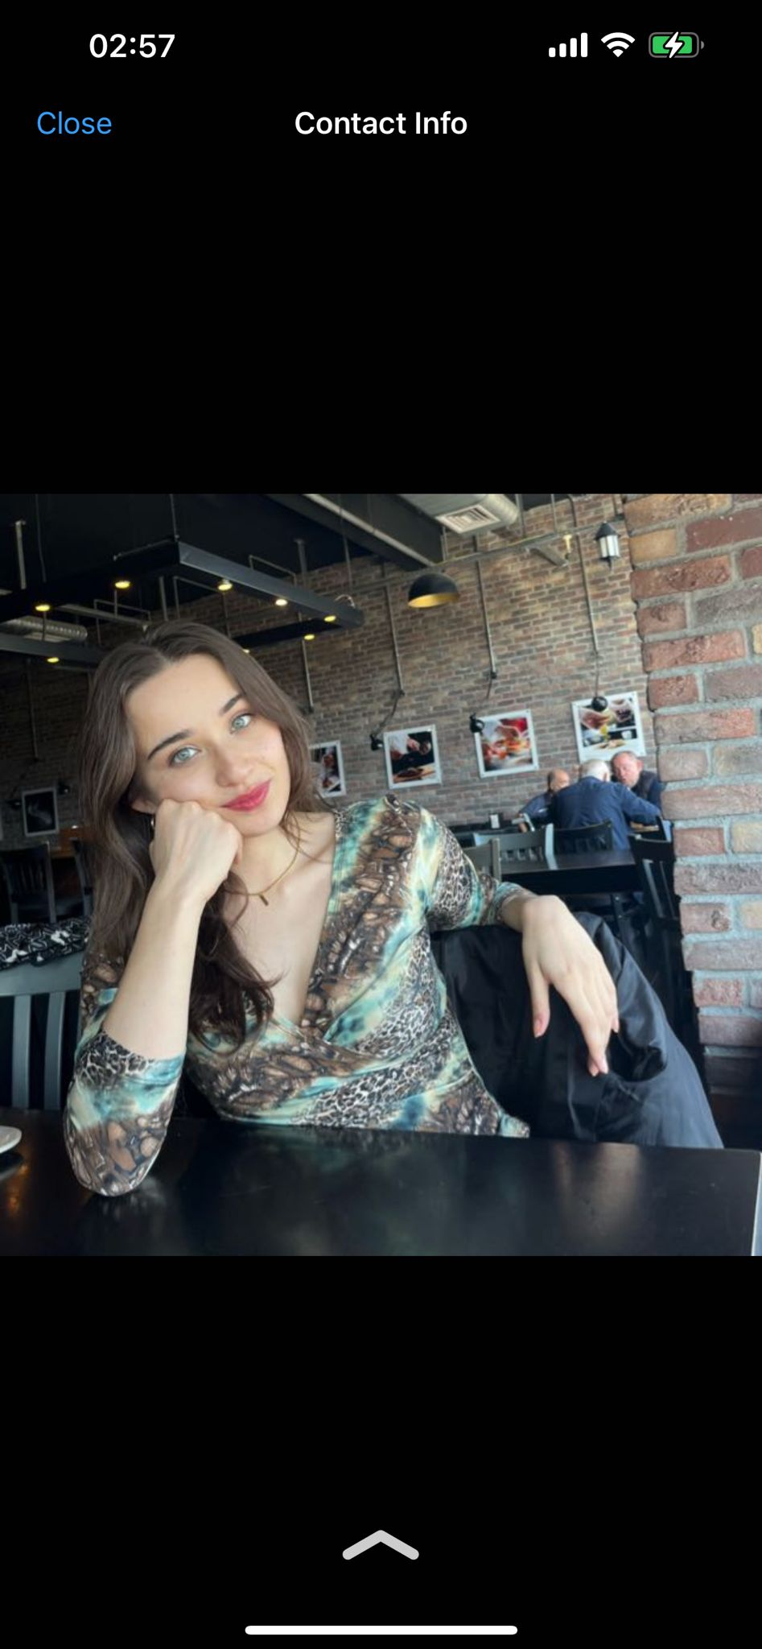
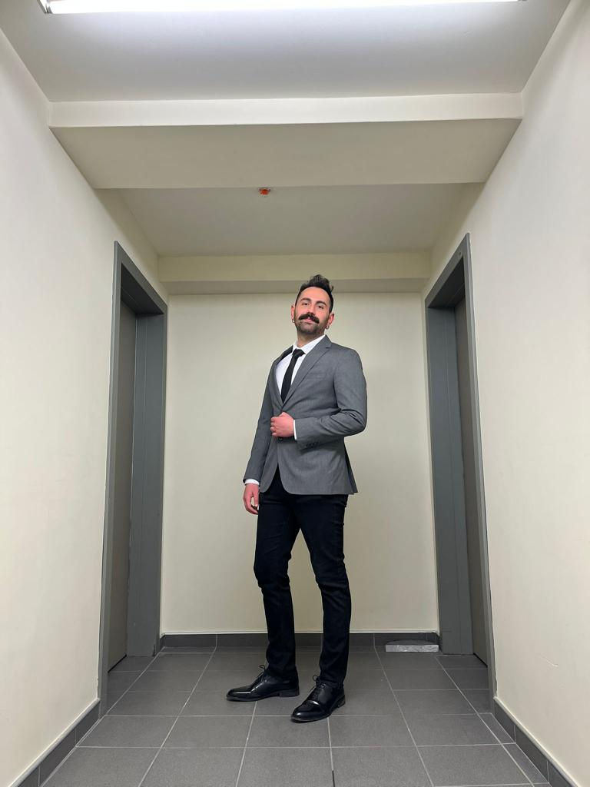
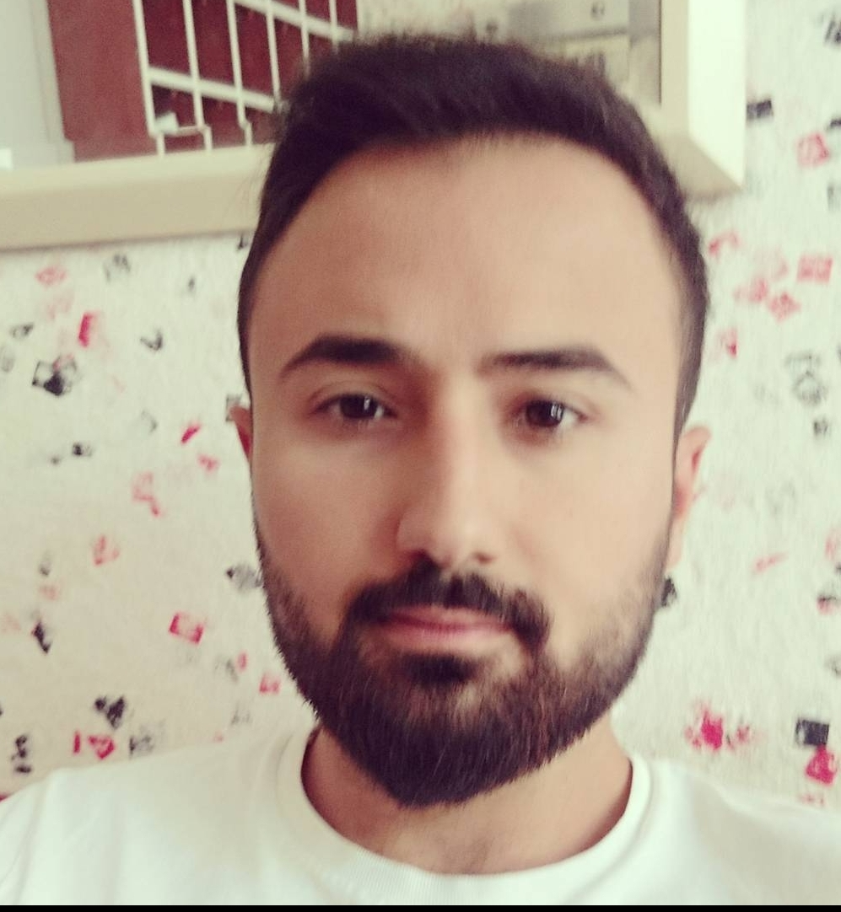
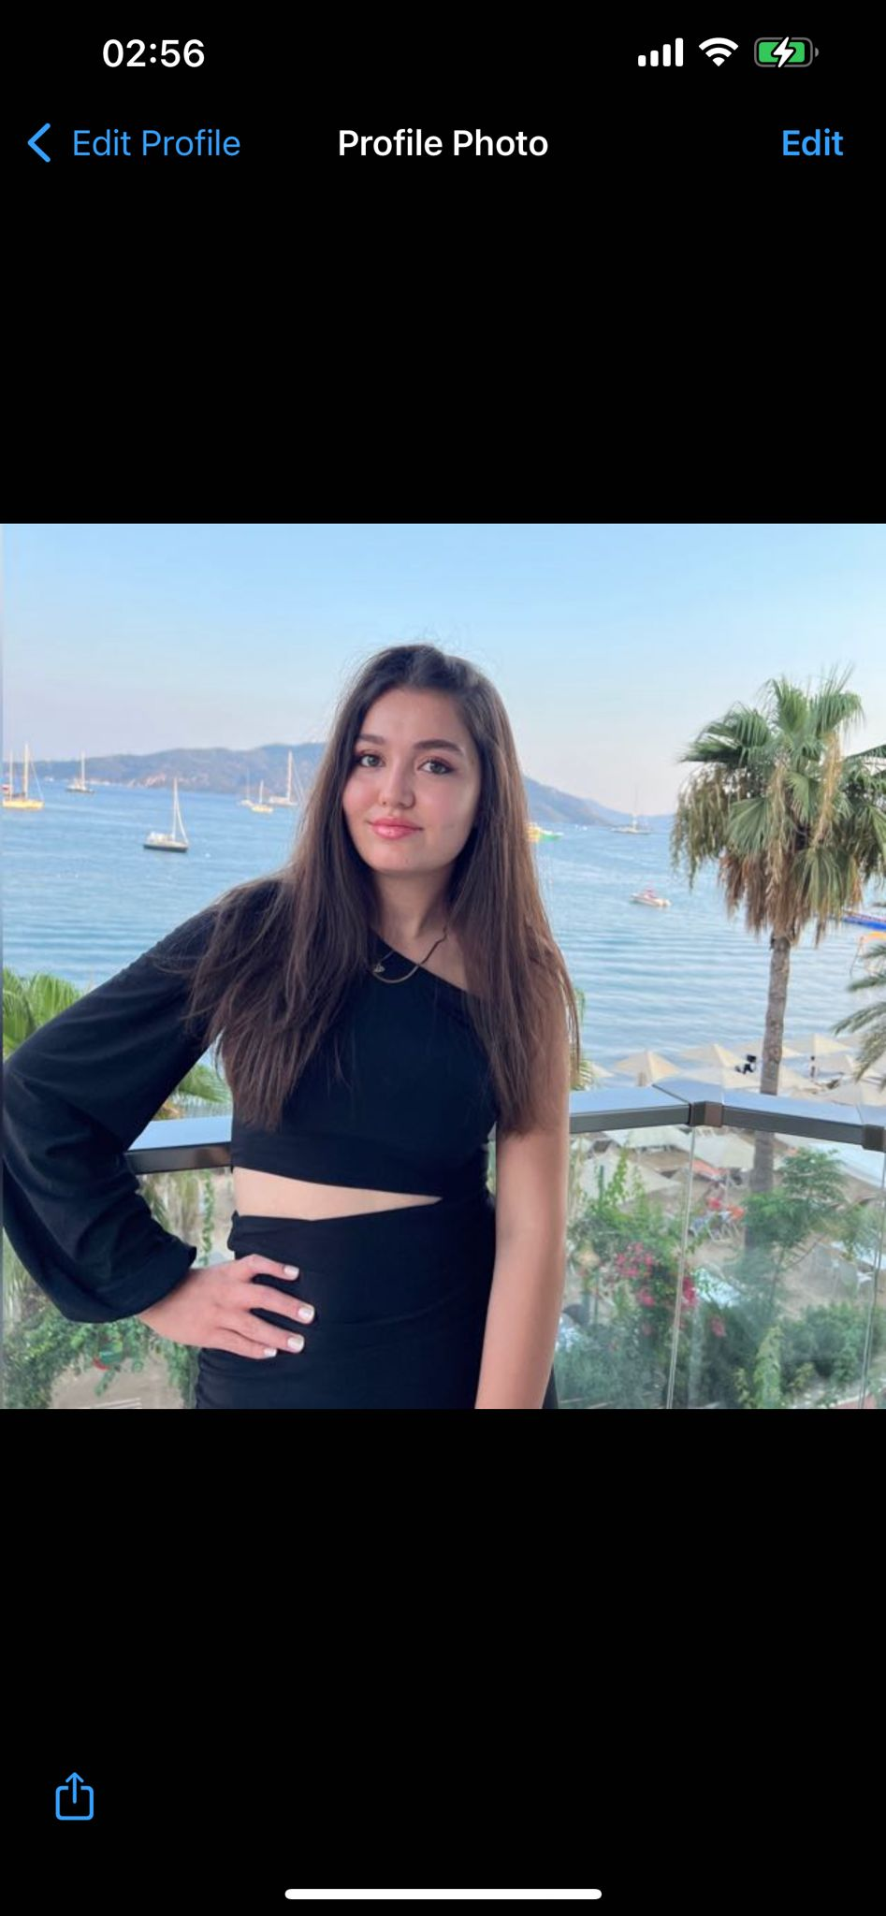
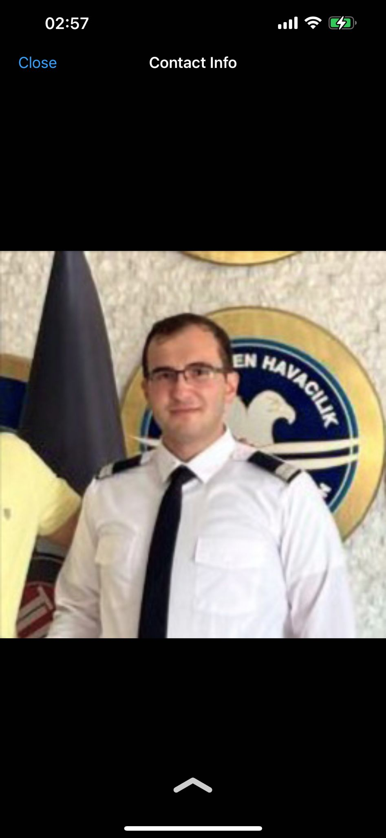
ATADAN
Umut Deniz ZORGÜL
Gizem AKGÖNÜLLÜ
Aybüke GÖKMEN
Özgür Bekir UZUN
Onur Kenan MARAŞ
Advisor: Dr. Gül TOKDEMİR
Çankaya University, Department of Computer Engineering
Abstract
Many plant health systems around the world have fund seriously in the cure of different illness, but they yet fall behind when it comes to exploring ways to get ahead of them. Because plant diseases are spreading quickly, decision support systems are needed to detect them early and make wiser judgments on how to properly treat them. In this project, our major goal is to provide an application for those who wish to monitor their plants when they suspect a disease threat.
Solution
Thanks to the ATADAN mobile application, plant owners or agricultural people will be able to diagnose plant diseases early and accurately by taking a photo of their plant or adding it from an album. The application will easily show the user the natural or chemical solutions of diseases. At the same time, it will show the pesticide shops closest to the user's location on the map. There is a part where you will contribute to AI. ATADAN administrators can view and download the photos uploaded by users on the web page and use them in model training.In the solution stages of these applications, we used machine learning, image processing, TensorFlow AI model, CNN and various classification algorithms. On the mobile application side, we used .Net Maui, Onion, Control Maps, Six Labors.
Figure 1 – Activity Diagram
Figure 2 – Activity Diagram
Introduction
With the ATADAN mobile application, you can quickly reduce plant disease symptoms on the leaves. It gives you the ability to take pictures and monitor changes over time, making it easy to monitor the health of your plants over the long term. We will take a photo of a plant and then show the user the type of plant, its disease and remedies. At the same time, our application will show the closest pesticide dealer to the user. The user can then make a personal album about a particular plant so that they can track changes such as the plant becoming infected or changing color.
Results & Conclusion
The main purpose of our project is to create an application to guide people. Our research has shown us that people who think that their plants have a disease can reduce the death rate in plants by using our application and that people who use our application can be more conscious about plant diseases. As a result, you can detect the disease from the photo of the plant from our mobile application and you can find solutions for this disease or the nearest pesticide dealer to your location. With this application, you can also contribute to the AI model. Authorized persons can view and download the photos that users have uploaded to the web page and use them in model training.
Figure 3 – Use Case Diagram
Acknowledgement
We would like to thank our advisor Gül Tokdemir for introducing us to this project and for her support.
Web Page
Figure 4 – Class Diagram
OUR TEAM
Gizem AKGÖNÜLLÜ
Umut Deniz ZORGÜL
Mobile Application
Gizem AKGÖNÜLLÜc
Aybüke GÖKMEN
Onur Kenan MARAŞ
Özgür Bekir UZUN

